Slide 1
1 Planed
Planed 1
Master the PE file format
Write blog about the understanding of PE file format
4

Slide 2
1 Results
Results 1
Have mastered the theory of PE file format.
Have written two blogs for PE .
I planed to write a blog in GeeksforGeeks but it may not be same as CSDN when i tried to write.
I forget some of my questions,maybe i should write down questions immediately when it hits me.
4

Slide 3
2 Results
Results 2
Now i am able to do a parser for DOS Header by myself,and maybe tomorrow i wiil have been able to finish a Rich Header parser.
Now i am trying to finish the first and second laboratory.
I still have some questions of the details that i will ask in this ppt.
All in all it is not difficult for me to understand the code of parser and write the code of the parser by myself.It just takes time.
4

Slide 4
1 Challenges and Solutions
Challenges and solutions 1
What is the IMAGE_DIRECTORY_ENTRY_COPYRIGHT ?why is it commented?What does it mean?What is the function of it?
4

Slide 5
2 Challenges and Solutions
Challenges and solutions 2
Why define the constant?I tried to find where the constant is used,but failed.By its name,i deduce that it is the size of section of the image file?
4

Slide 6
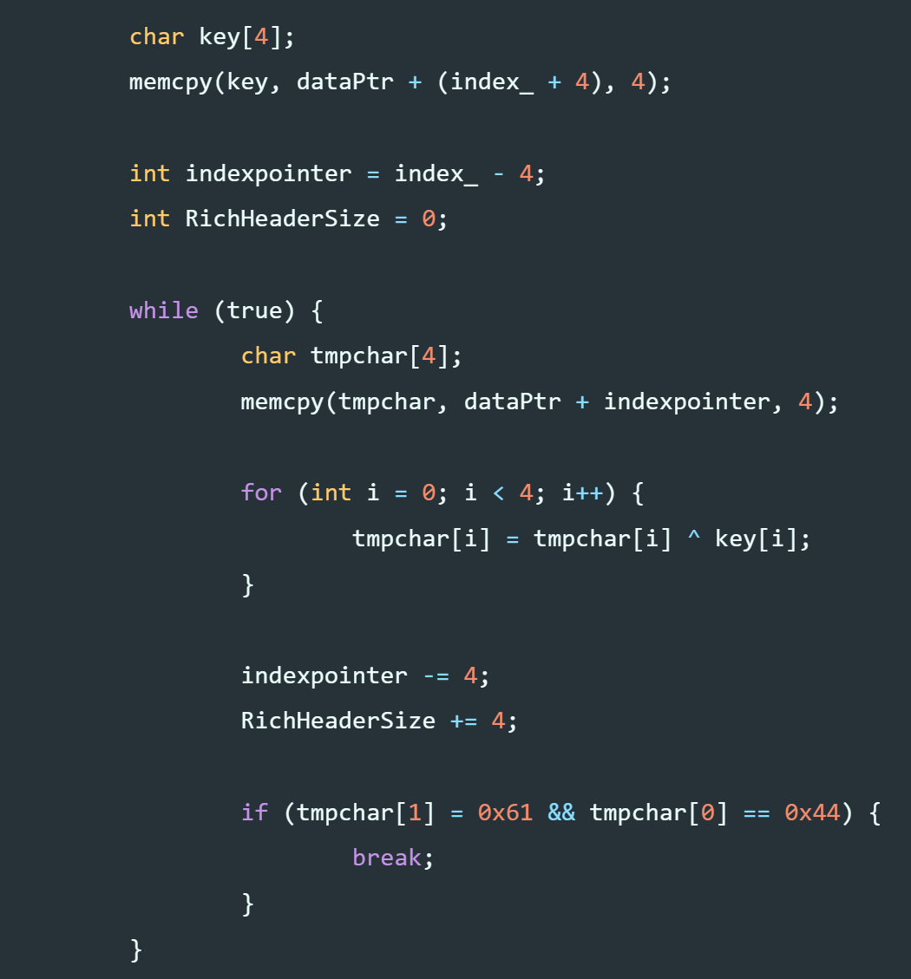
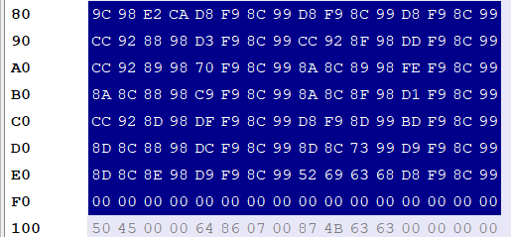
3 Challenges and Solutions
Challenges and solutions 3
In this code,the ‘index_’ is the index of the ‘R’,so the way to calculate the size of the Rich Header is not its real size,right?
Please look at the screenshot,the blue part is the Rich Header but the size calculated is not the whole area.
the index calculated is the 0xD9 index
4

Slide 7
1 Plan
plan 1
Master the code of the parser!
Finish the first two laboratory by myself!
I plan to start to study assemble language in this week if i can finish the laboratories quickly.
4

